Slide 1
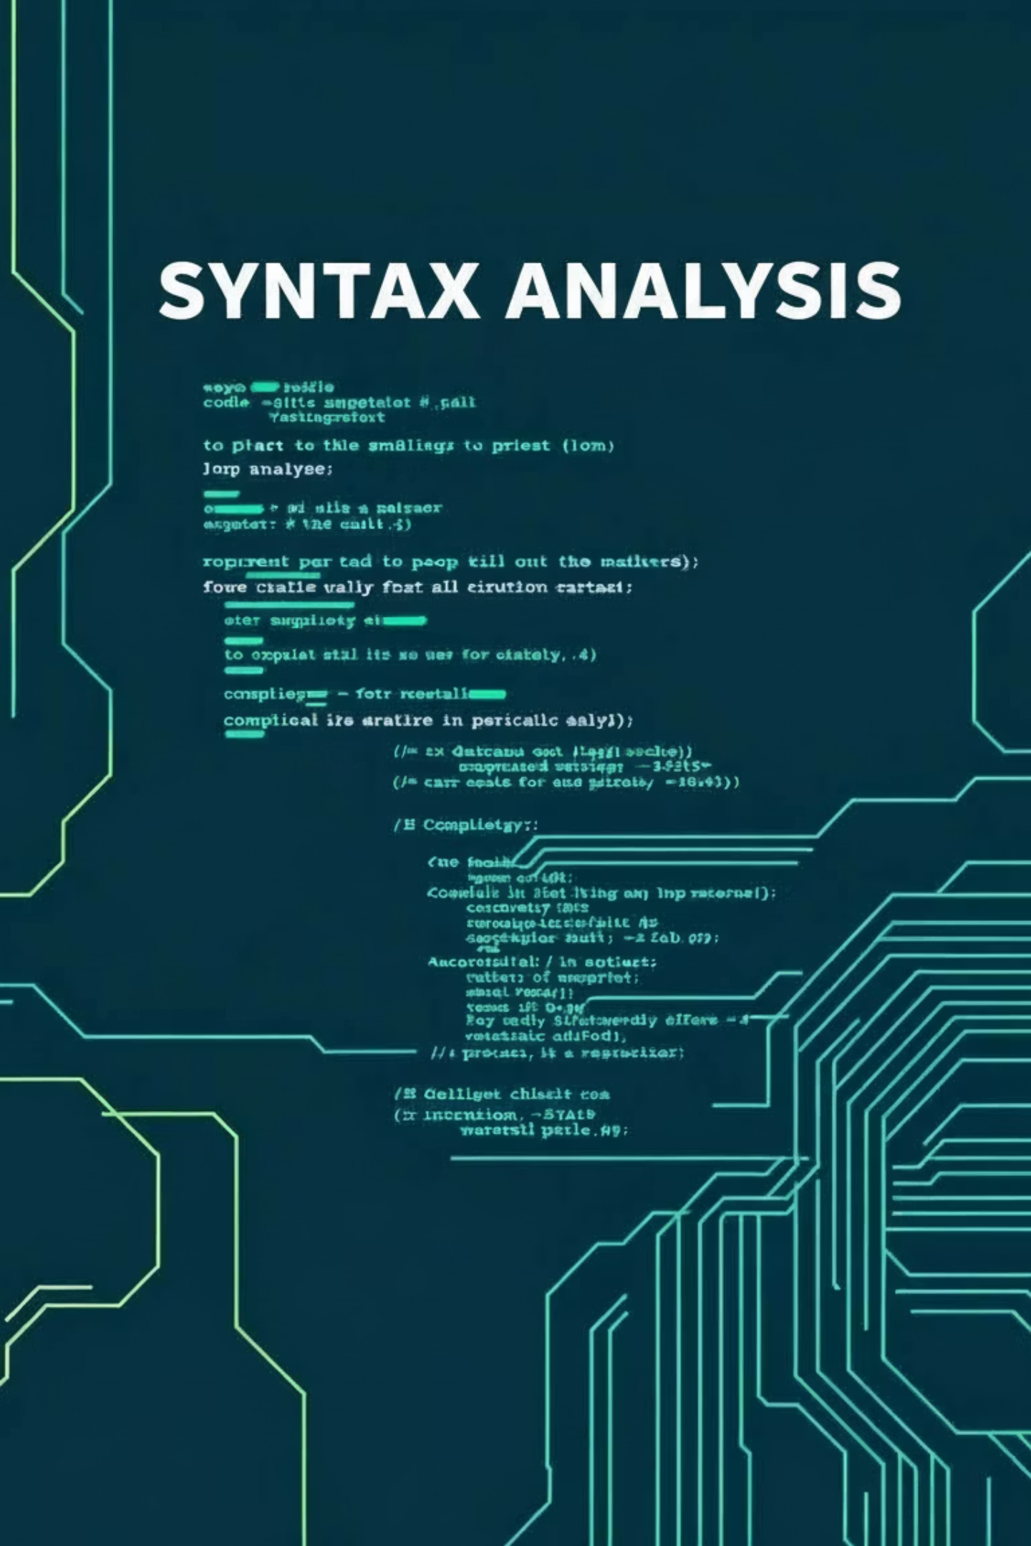
Principles of Compiler Design
Syntax Analysis (Parsing)
Individual Assignment 02
QUESTION- 39 Name: Abrham Abebaw Course Code: SEng4031 Id: BDU1504862 Section: B

Slide 2
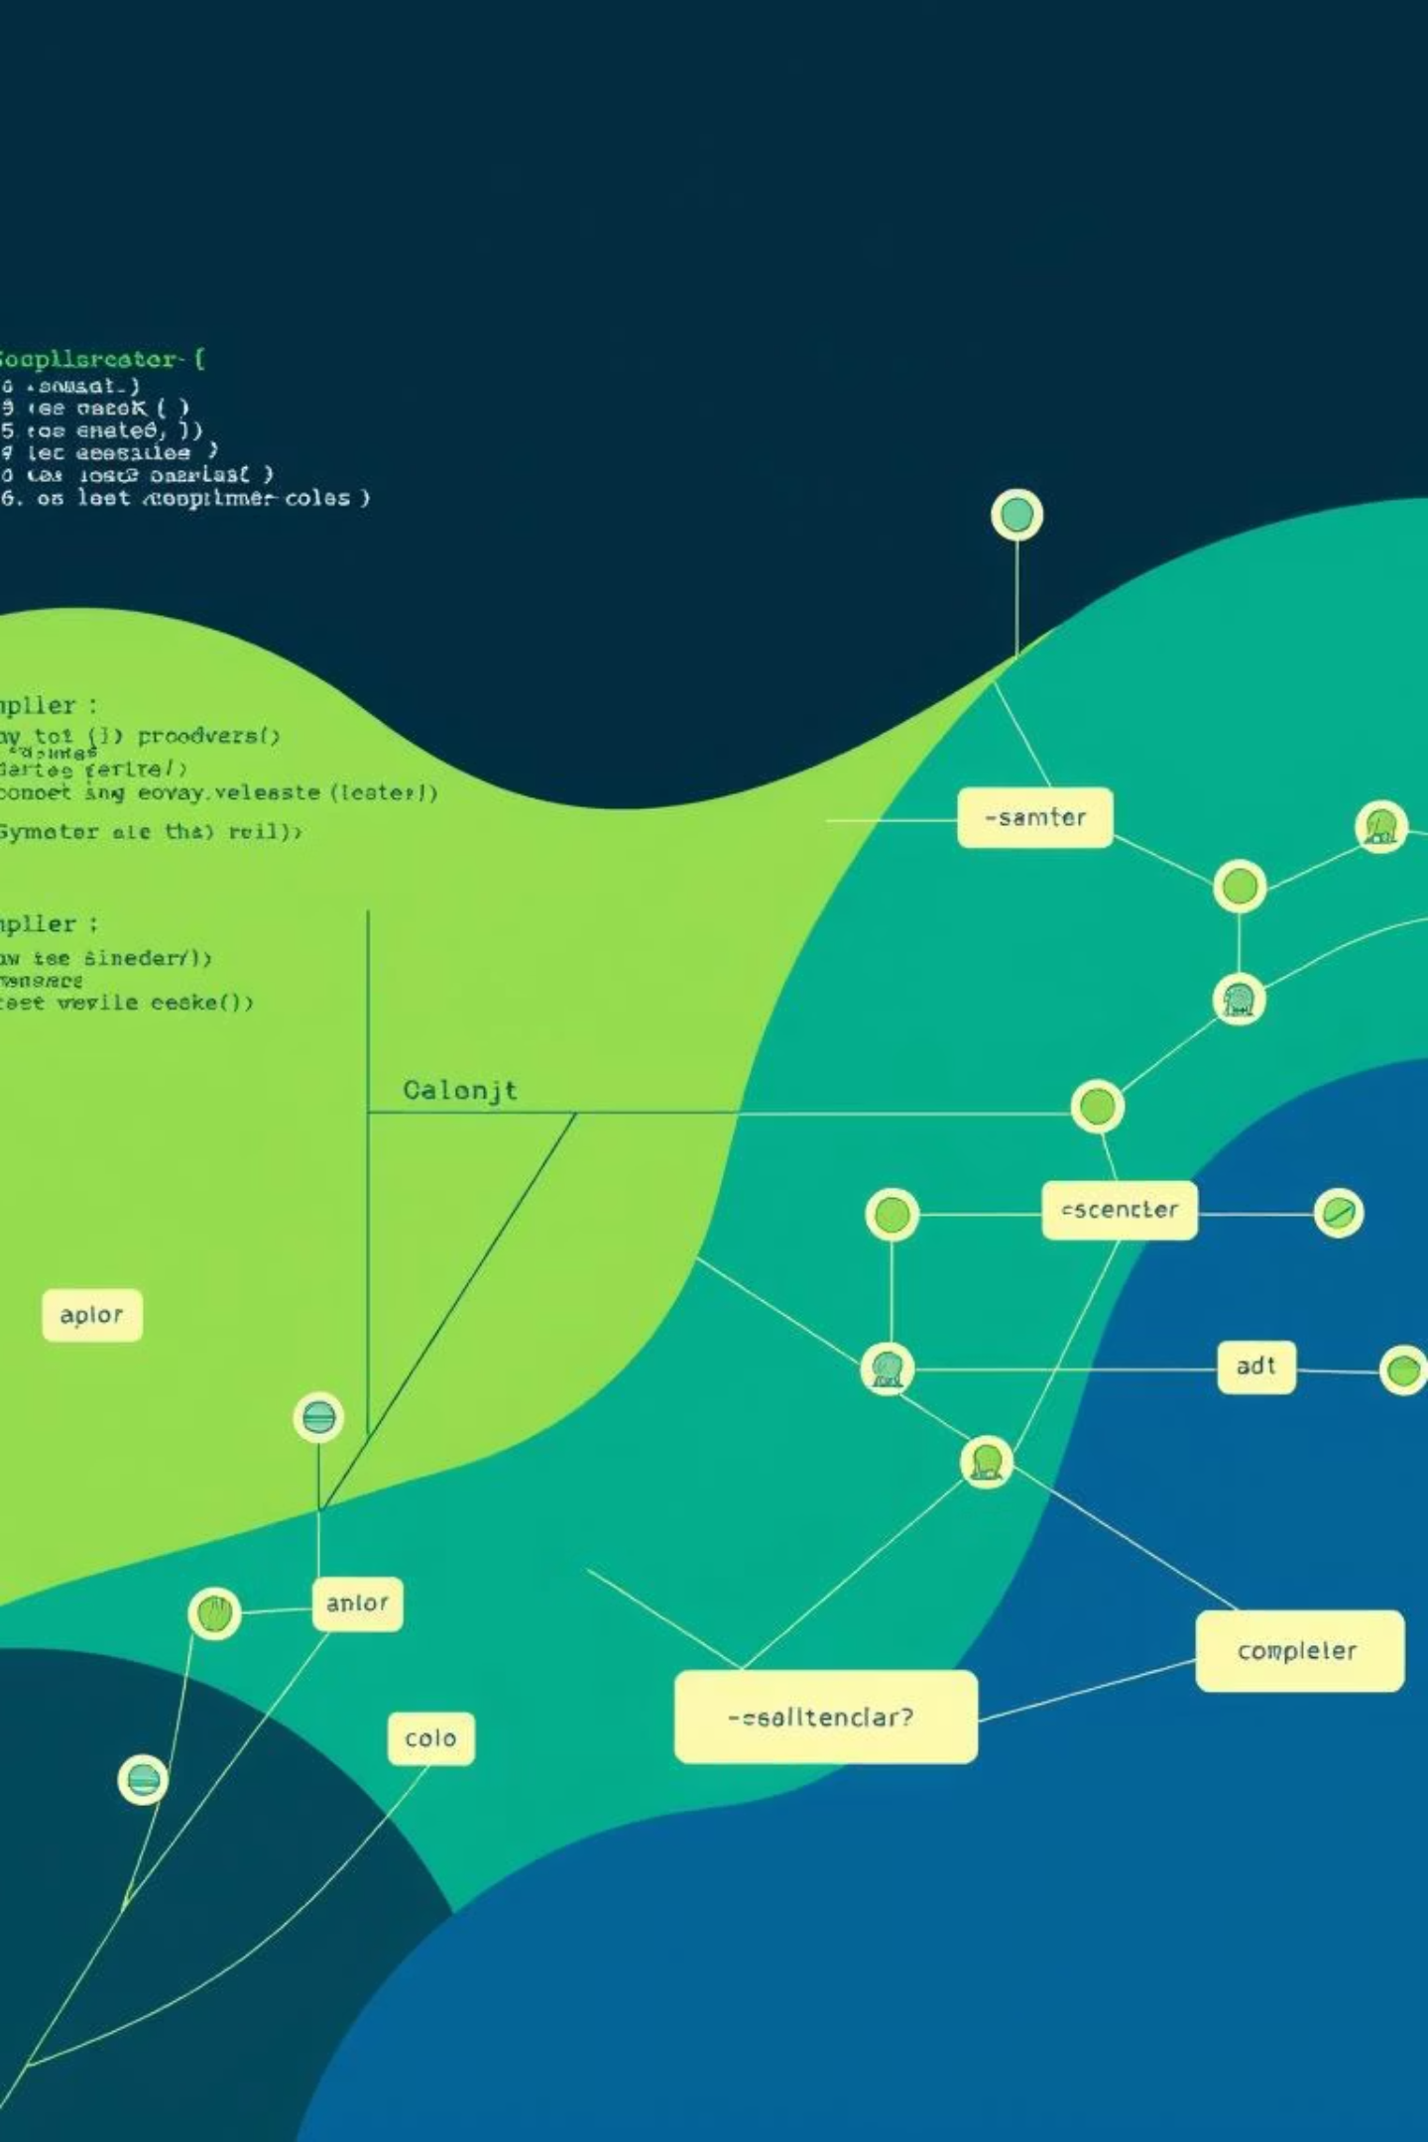
1
Introduction to Context-Free Grammars
Context-Free Grammars (CFGs) are fundamental in syntax analysis and compiler design. They formally describe language structure, defining how symbols combine into valid strings. These rules are crucial for parsing, where compilers verify input adherence to grammatical rules.

Slide 3

2
Classification of CFGs
Ambiguous Grammars
A single string can have multiple derivation (parse) trees, leading to unclear or inconsistent program behavior. This complicates parsing.
Unambiguous Grammars
Every valid string has exactly one derivation tree, ensuring a single, consistent interpretation. This makes parsing simpler and more reliable.

Slide 4


3
Formal Definition of Ambiguity
A context-free grammar is formally represented as G = (V, T, P, S). Ambiguity occurs if at least one string in the language can be generated in more than one way, producing multiple parse trees.
V = Set of variables (non-terminal symbols)
T = Set of terminal symbols
P = Set of production rules
S = Start symbol

Slide 5




4
Understanding Ambiguity in CFGs
Ambiguity arises when a grammar allows a string to be generated through different sequences of rule applications. This can be observed through Leftmost Derivations (LMDs) or Rightmost Derivations (RMDs).
Multiple Derivations
Different rule application sequences for the same string.
Different Parse Trees
Multiple hierarchical structures for the same terminal string.
Confusion in Interpretation
Problematic for programming languages and compiler construction.

Slide 6
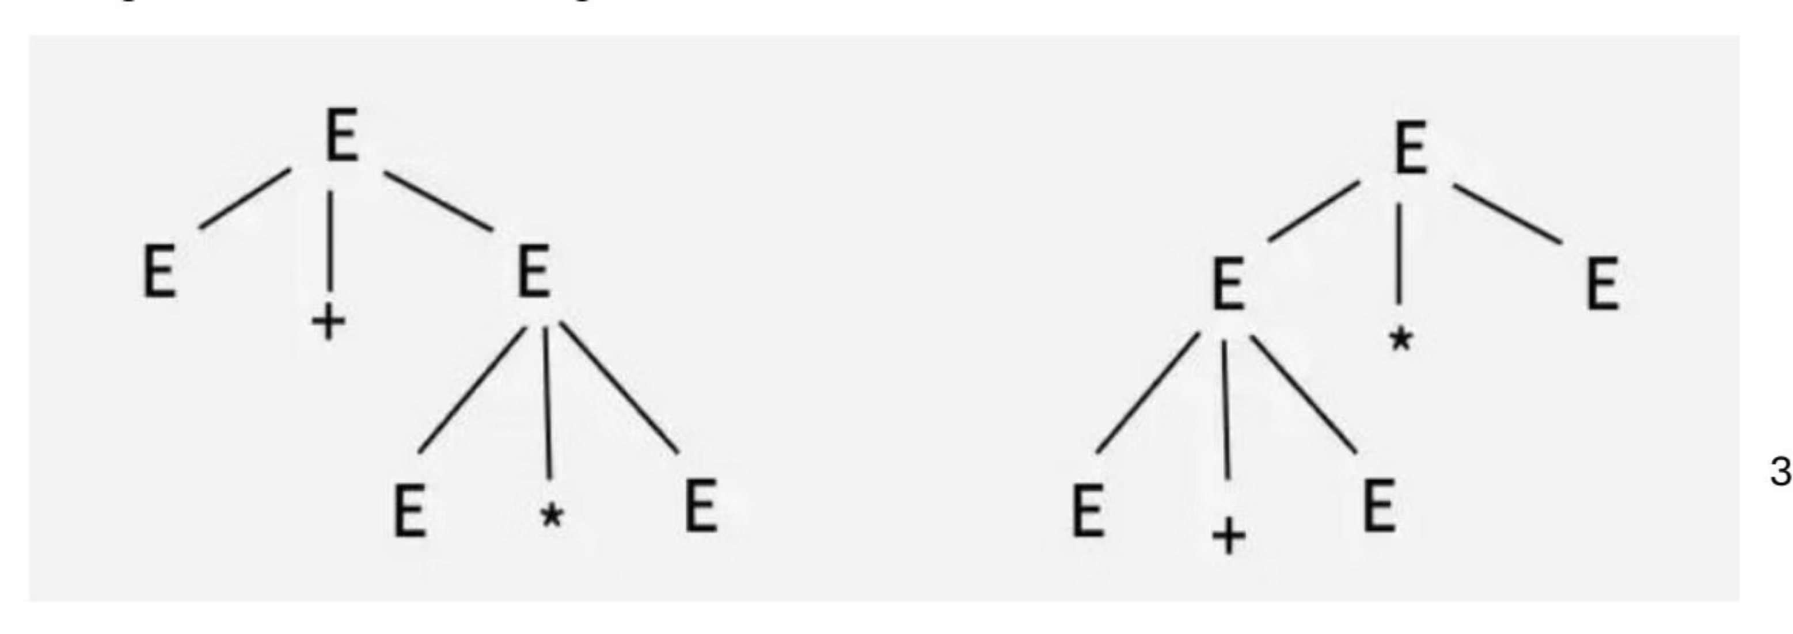
Example: Ambiguous Grammar
Consider the grammar: E → E + E | E * E | id. The string "id + id * id" can generate two different parse trees, making the grammar ambiguous.
Both trees derive the same string but represent different interpretations of operator precedence.

Slide 7
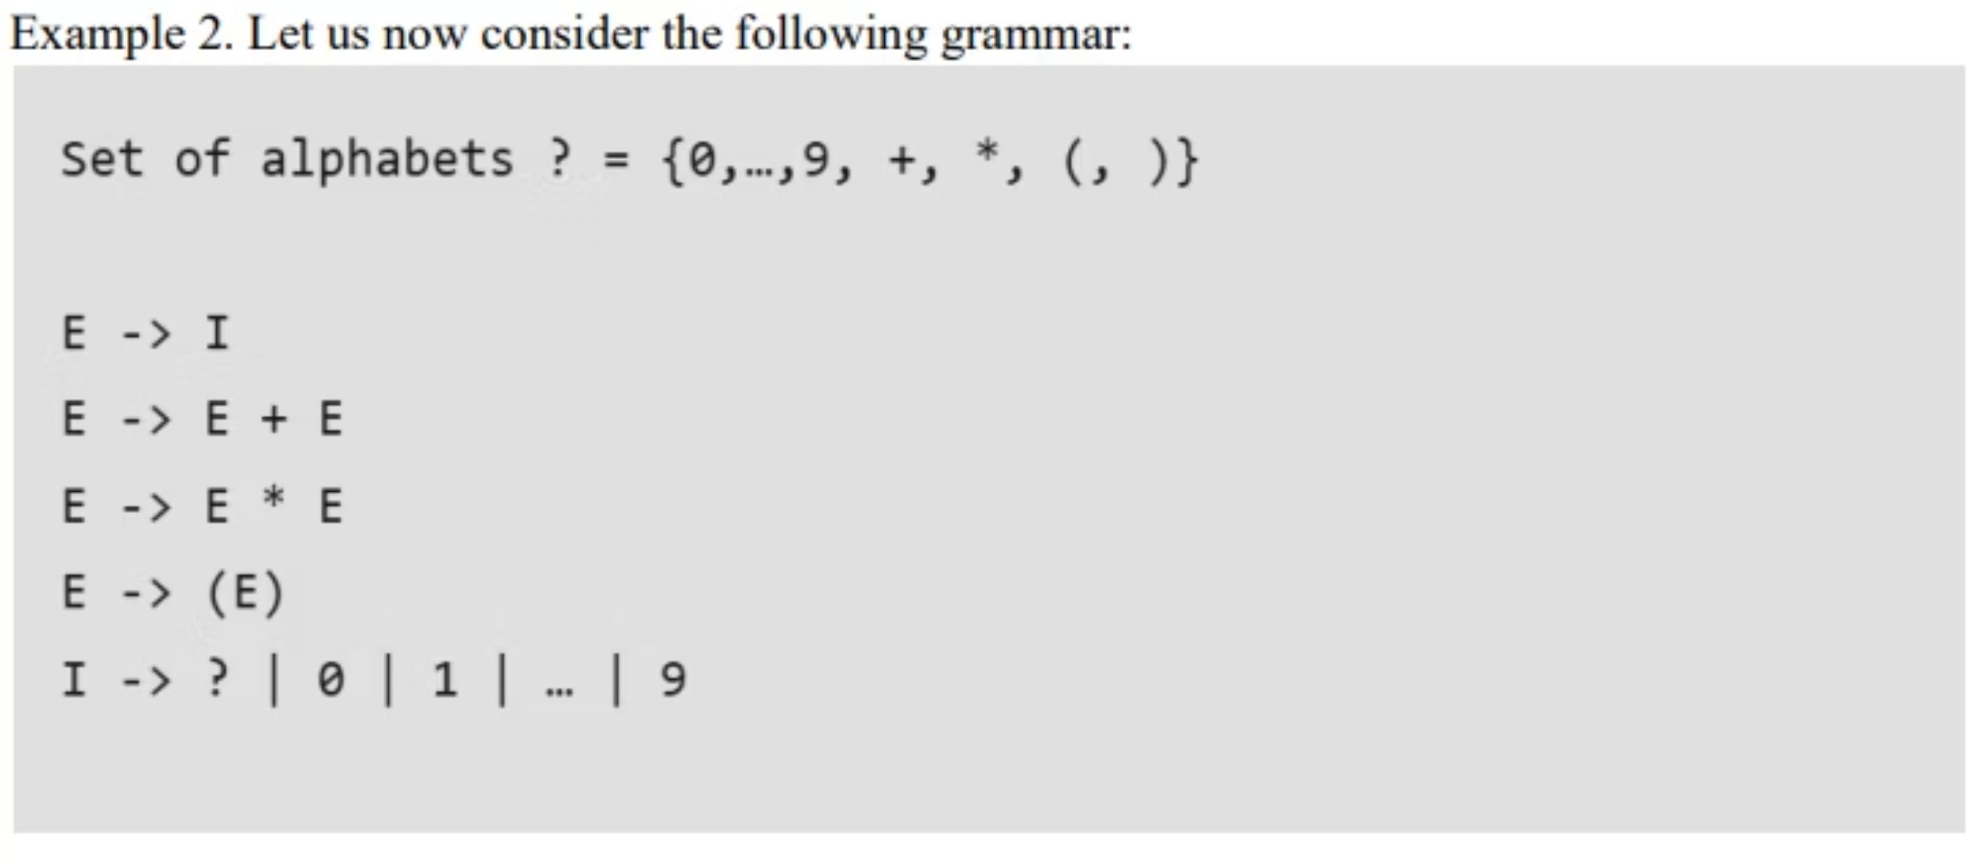
cont…

Slide 8
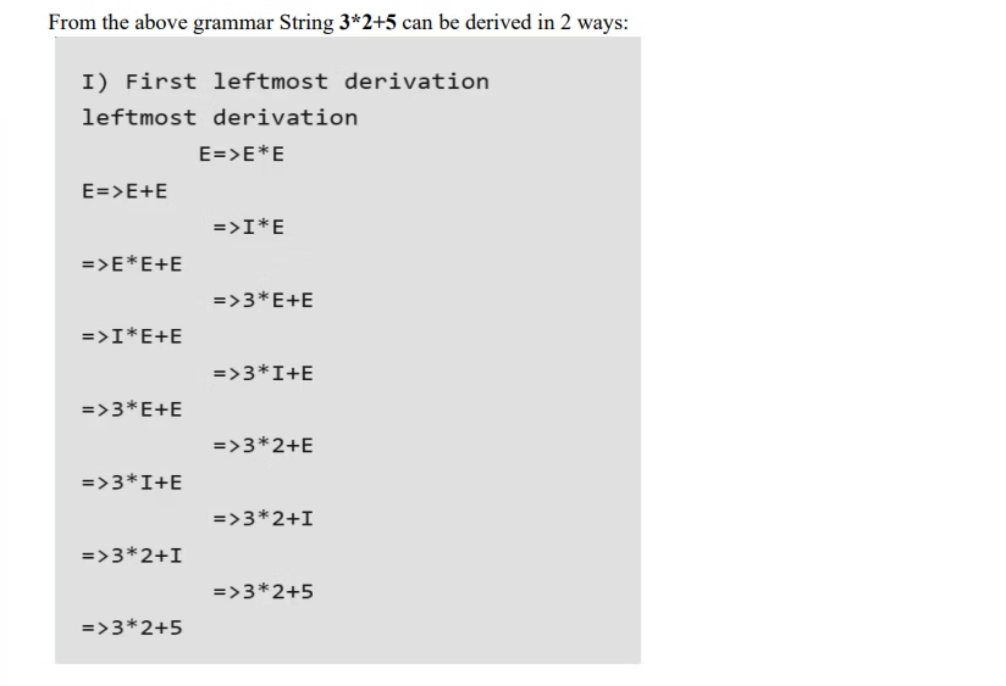
cont…

Slide 9
cont …
Following are some examples of ambiguous grammar:
• S-> aS |Sa| ?
• E-> E +E | E*E| id
• A -> AA | (A) | a
• S -> SS|AB, A -> Aa|a , B -> Bb|b
Whereas following grammars are unambiguous:
• S -> (L) | a, L -> LS | S
• S -> AA, A -> aA , A -> b

Slide 10

5
Key Points on Ambiguity
Unclear Grouping
Ambiguity occurs when a grammar doesn't clearly specify how parts of a string should be grouped or structured.
Interpretation Confusion
Ambiguous grammars create confusion, which is problematic in programming languages.
Compiler Construction
Detecting and resolving ambiguity is essential to ensure correct program interpretation.
Predictability
Unambiguous grammars are preferred for simpler, more predictable, and reliable compilers.

Slide 11
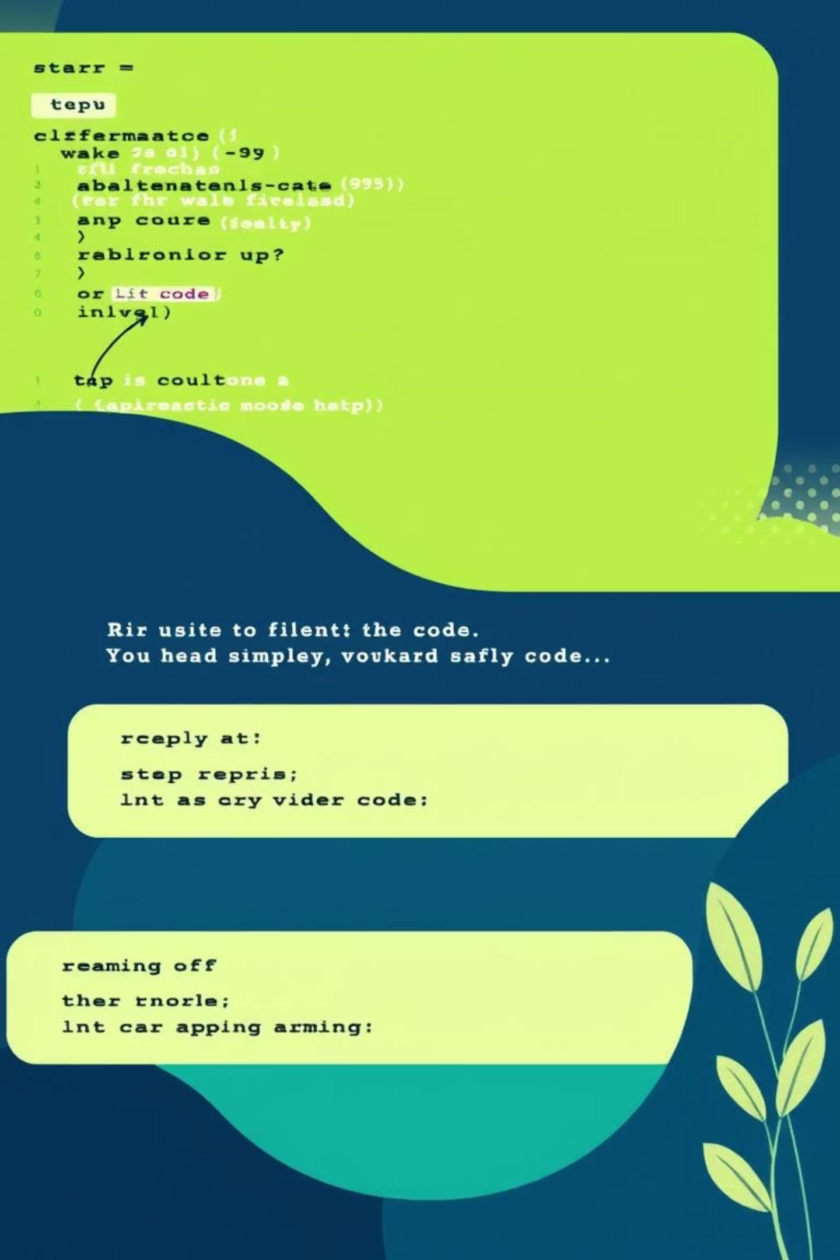
6
Removing Ambiguity in Grammar
01
Simplify Production Rules
Break down complex rules into smaller, simpler ones to avoid multiple interpretations.
02
Set Precedence & Associativity
Clearly define the order of operations (e.g., multiplication before addition, left-to-right grouping).
03
Fix Left Recursion
Change rules so recursion occurs at the end, preventing infinite loops.
04
Factor Out Common Parts
Combine common rule beginnings (e.g., A → αβ | αγ becomes A → αA' and A' → β | γ).

Slide 12

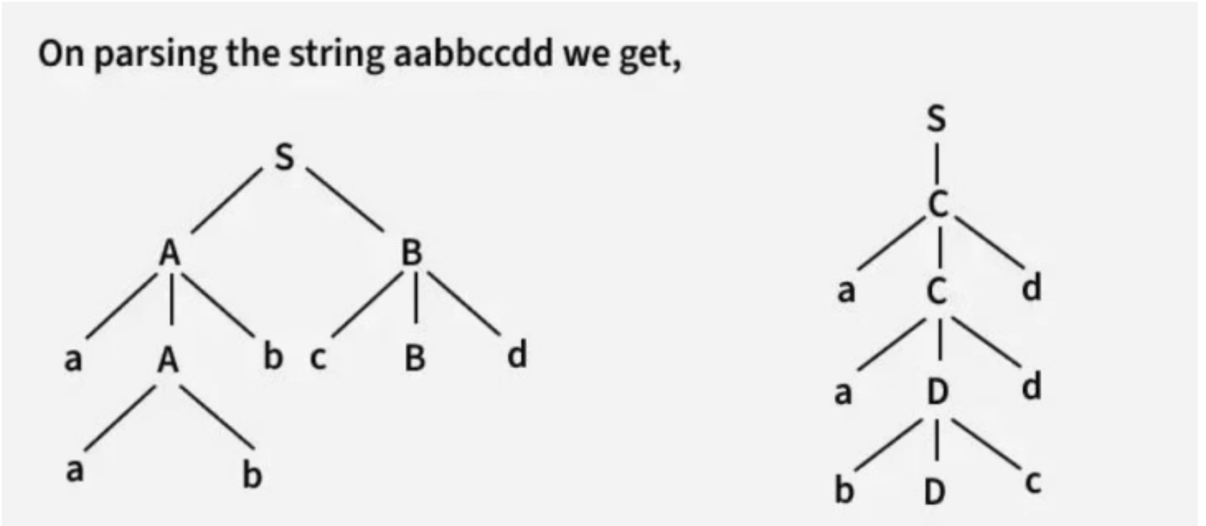
7
Inherent Ambiguity
A Context-Free Language (CFL) is inherently ambiguous if every possible grammar for it is ambiguous. This means no matter how the grammar is written, some strings will always have multiple parse trees.
Example Language L:
The string "aabbccdd" can be parsed in two distinct ways using different rules, demonstrating inherent ambiguity.

Slide 13
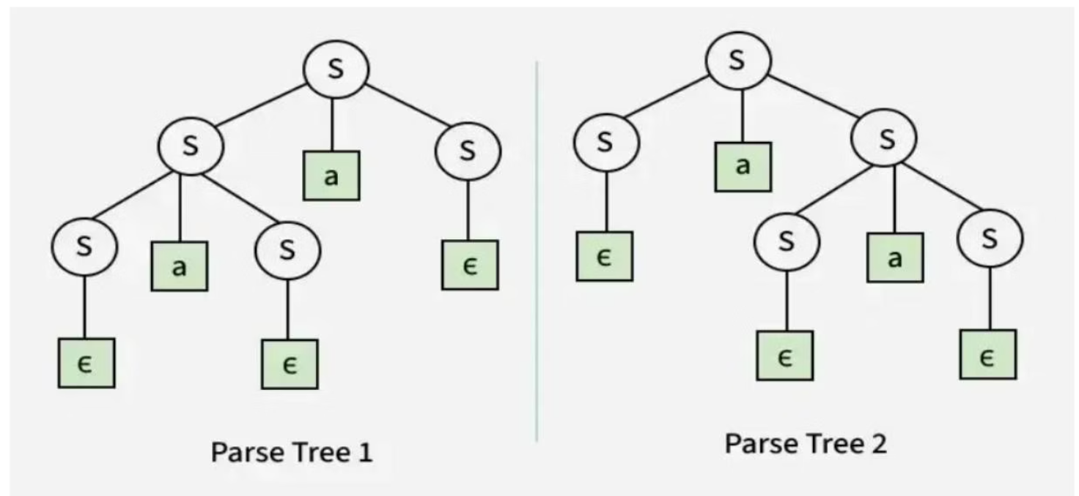
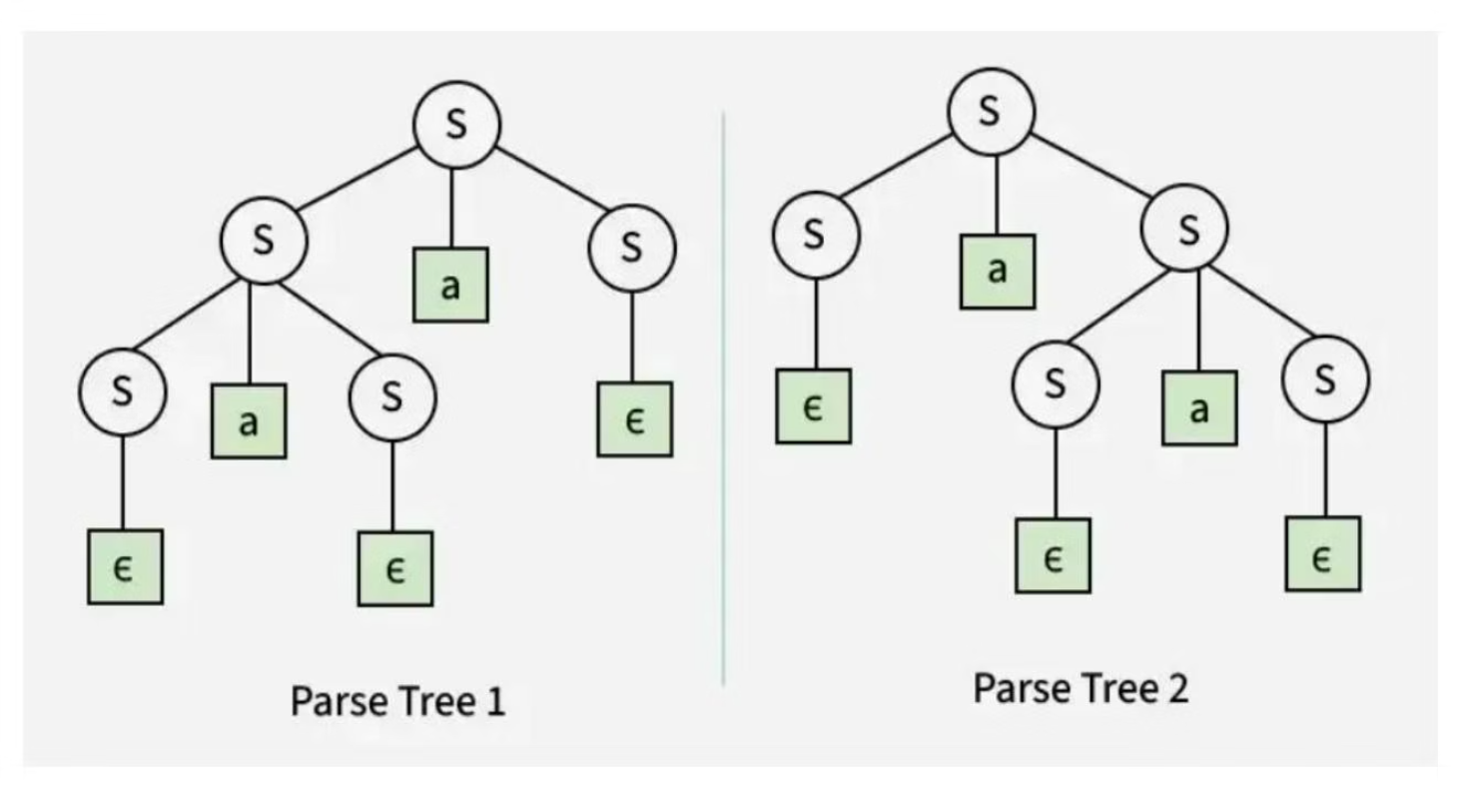
Important Points on Ambiguous Grammar
1
2
Left & Right Recursion
Absence of Recursion
Grammars with both left and right recursion (e.g., S → SaS | ε) are ambiguous, leading to multiple parse trees for strings like "aa".
Even without left or right recursion, a grammar can still be ambiguous. For example, S → aB | ab, A → AB | a, B → Abb | b can derive "ab" in multiple ways.

